Slide 1
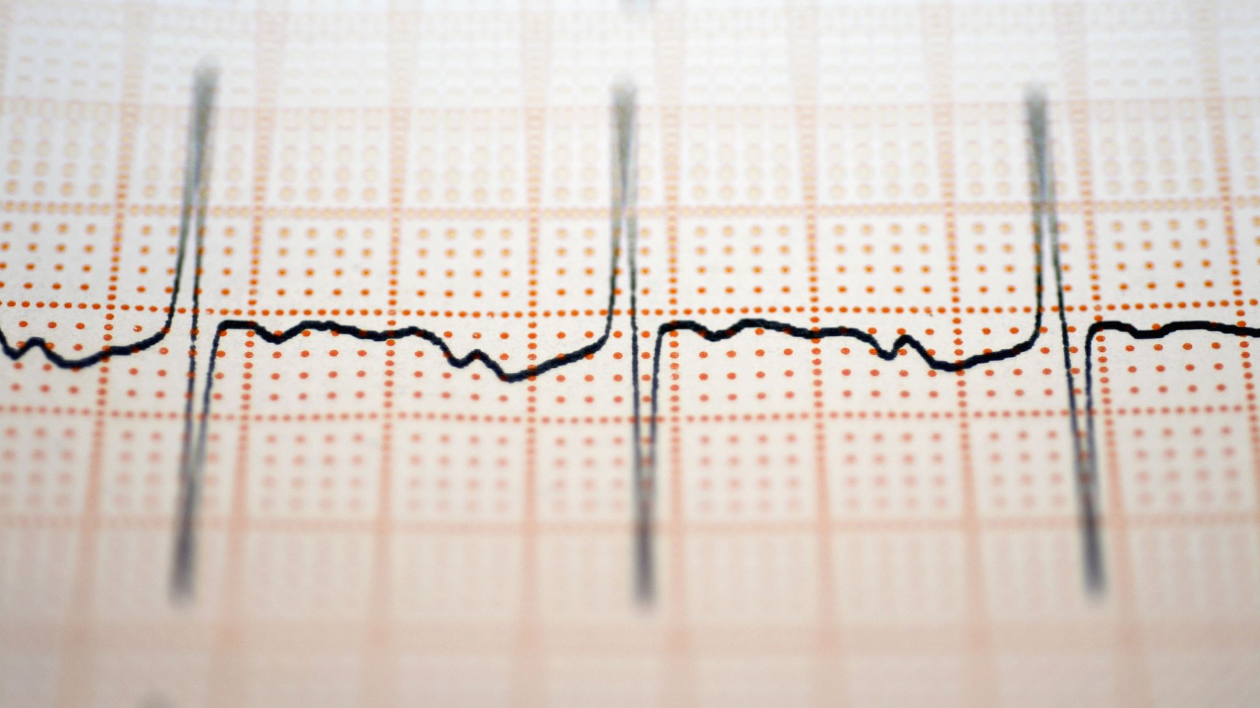
Cardiovascular Failure
Jeffrey Parmet
Dev Patel
Cedric Johnson II
Rowan Wiley

Slide 2
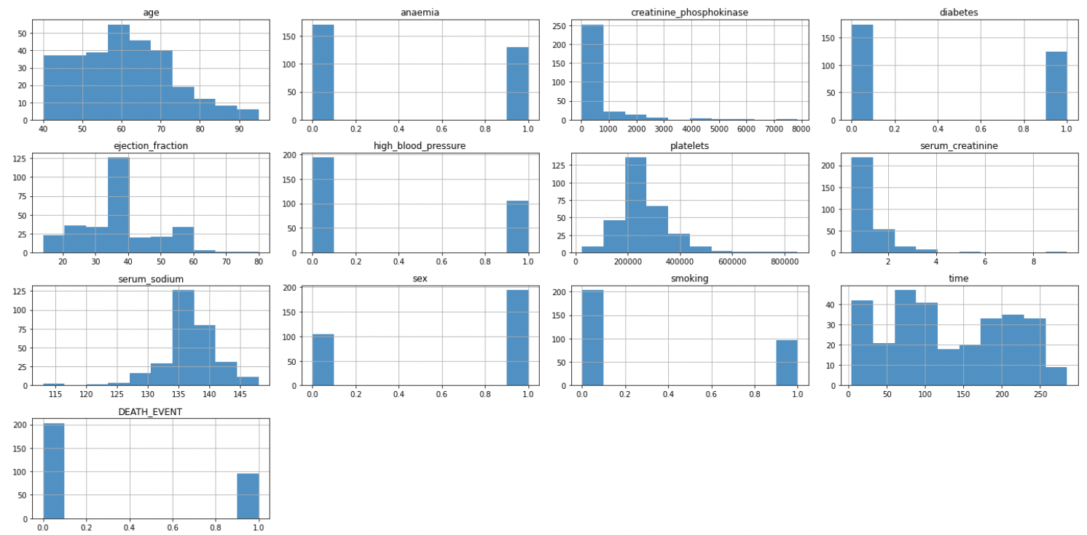
The Dataset
Clinical Factors
Age
Anaemia: No = 0, Yes = 1
Decrease of red blood cells or hemoglobin
Creatinine Phosphokinase
Level of the CPK enzyme in the blood (mcg/L)
Diabetes: No = 0, Yes = 1
Ejection Fraction
Percentage of blood leaving the heart at each contraction
High Blood Pressure: No = 0, Yes = 1
Platelets
Serum Creatinine
Serum Sodium
Sex: Female = 0, Male = 1
Smoking: No = 0, Yes = 1
Output
Time
Follow-up period (days)
Death Event: No = 0, Yes = 1

Slide 3
k-Nearest Neighbors Model
I split the data into training and testing data using the train_test_split function provided by scikitlearn
I separated the data using four different random states in order to get a range of results
I used a k-value of 17 because that was the closest odd integer to the square root of 299 (the total number of samples (n))

Slide 4
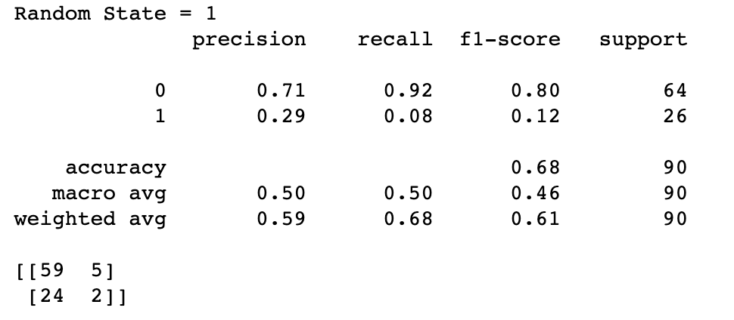
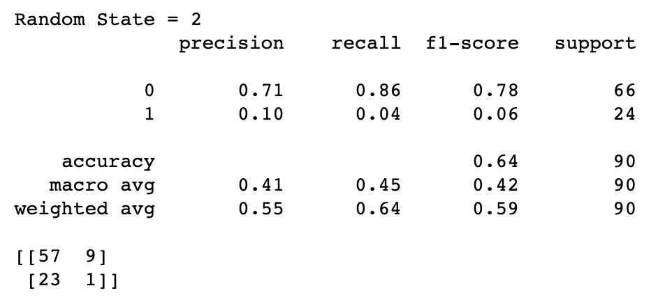
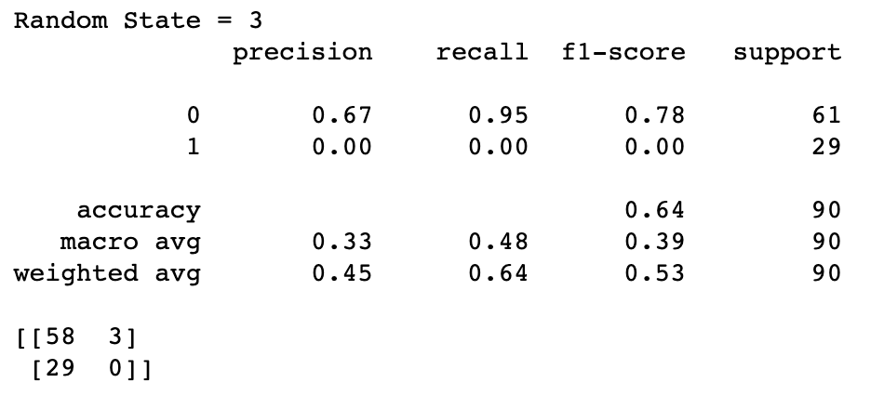


Slide 5
Results
For Death Event = 0 (No death):
The precision was between 0.67 and 0.72.
The recall was between 0.86 and 0.95.
The f1-score was between 0.78 and 0.82.
The accuracy was between 0.64 and 0.70.
For Death Event = 1 (Death):
The precision was between 0.00 and 0.29.
The recall was between 0.00 and 0.08.
The f1-score was between 0.00 and 0.12.
The accuracy was between 0.64 and 0.70.

Slide 6
Observations
The model was very good at predicting positives, correctly identifying 92.22% of true positives (237/257).
However, it struggled with negatives, correctly identifying only 2.91% of true negatives (3/103).
I believe this is because we used a dataset with 203 entries where death event was 0 (no death) compared to 96 entries where death event was 1 (death). This imbalanced dataset may have affected the model.
With a k-value of 17, odds are that there will be more no death neighbors than death neighbors, just based on sheer numbers.
This is supported by the fact that the vast majority of the errors made by the model (100/120) were false positives rather than false negatives.
The model had an accuracy of 66.5% on average, but if it just guessed no death for every individual it would have had an accuracy of 67.89%.

Slide 7
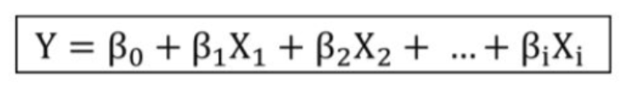
Multiple Linear Regression
Multiple Regression models enable us to determine relationships between multiple predictors and a response variable.
Steps:
Determine number of predictors
Split dataset into training and testing sets using sklearn’s train_test_split function
Perform model

Slide 8
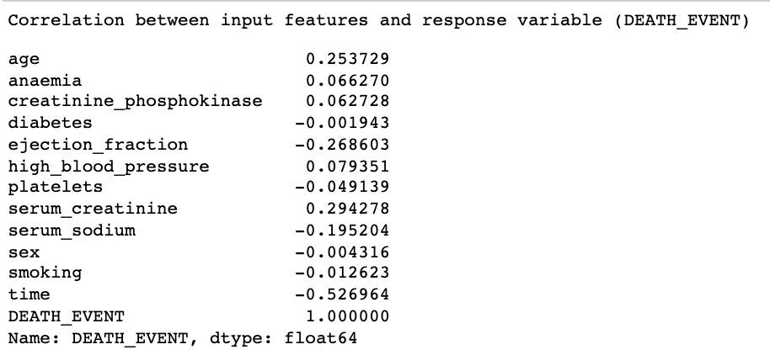
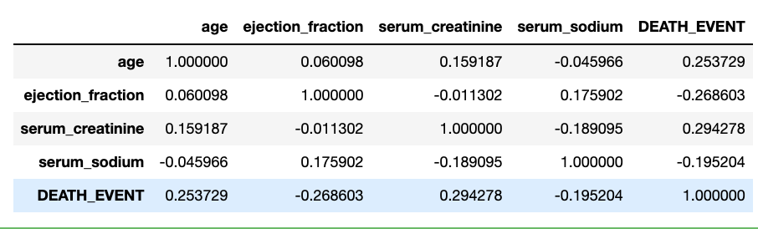
Multiple Linear Regression
Using the predictors age, ejection fraction, serum creatinine, and serum sodium to predict heart failure
Reduced set of predictors to size 4, consisting of input features that exhibit the greatest correlation with the response variable, DEATH_EVENT.

Slide 9
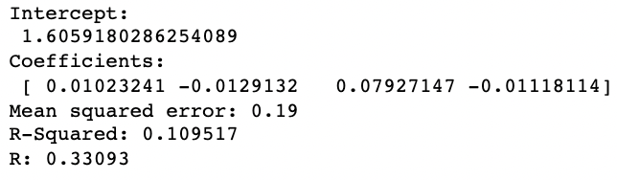
Multiple Linear Regression
Using the predictors age, ejection fraction, serum creatinine, and serum sodium to predict heart failure
Final Model Equation
DEATH_EVENT = 1.60592 + (0.01023)*Age + (-0.01291)*EjectionFraction + (0.07927)*SerumCreatinine + (-0.01118)*SerumSodium
Results
Our R value of 0.331 indicates that there is a relatively weak relationship between our predictor set and the outcome variable. Our model does not serve as a great predictor of heart failure outcomes.
The results of this model also indicates that approximately 11% of the variance in the likelihood of a heart failure death event is explained by the use of this predictor set (Age, Ejection Fraction, Serum Creatinine, Serum Sodium).

Slide 10
Random Forest Model
A Random Forest is a meta estimator that fits a number of decision tree classifiers on various sub-samples of the dataset and uses averaging to improve the predictive accuracy and control over-fitting.
Split the data into training and testing using train_test_split() with 2 random states.
Dropped the Time column.
The pros of Random Forest are that it is robust to outliers, works well with non-linear data, lowers the risk of overfitting, and runs efficiently on a large dataset.
Source: https://scikit-learn.org/stable/modules/generated/sklearn.ensemble.RandomForestClassifier.html

Slide 11
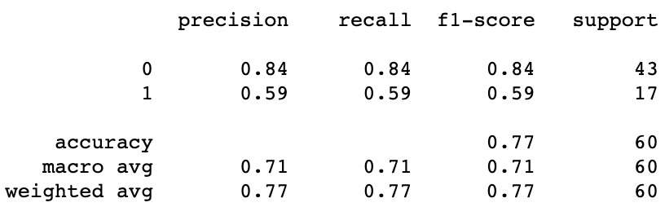
Results
For No Death (0), Precision is 84%
For Death (1), Precision is 59%
Accuracy of 77%

Slide 12
New Model: Learning Vector Quantization
Prototype-based, supervised
Prototype – A hypothetical data point which represents the “typical” set of data leading to a particular label
In LVQ, a prototype is represented as a neuron
Related to K-Nearest Neighbor and Clustering
Measures distance between data point and a set of prototypes
Data is labeled as closest centroid neuron
Formal steps
Define clusters, centroids, learning rate, epochs counter, repetitions counter
For each epoch, take each input and select the winner neuron based on distance to centroid
Update weight of the winner neuron – closer to input if it was correct, further if incorrect

Slide 13
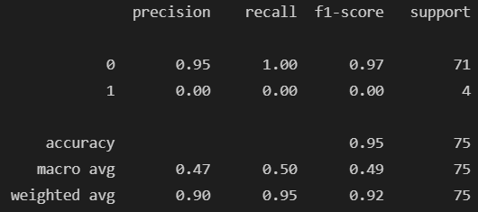
Results

Slide 14
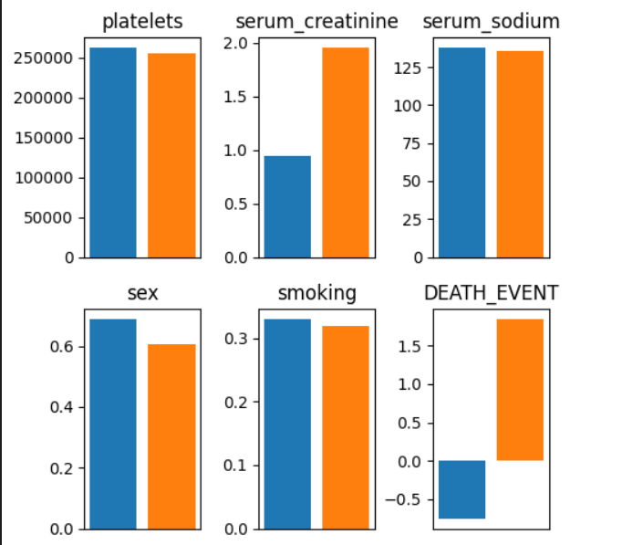
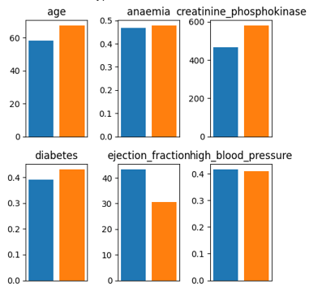
LVQ Prototypes No death (blue), death (orange)

Slide 15
Overall Results
Model | Precision | Recall | F1-Score | Accuracy
LVQ | .95 | 1.00 | .97 | .95
KNN | .70/.10 | .92/.03 | .80/.05 | .67
RF | .84 | .84 | .84 | .77
MR | R = .331 | R² = .109 | --- | MSE = 0.19

